Slide 1
Academic integrity is:
Acting with the values of honesty, trust, fairness, respect and responsibility in learning, teaching and research.
(Universities Australia, 2017)
Academic integrity
Professional
integrity
Personal integrity
=
=
Notes:
Academic integrity, professional integrity and personal integrity are all the same thing

Slide 2
Types of academic misconduct
Staff know that cheating occurs and will be looking, in particular, for:
Plagiarism
Collusion
Impersonation
Contract cheating
Notes:
.

Slide 3
Complete your Academic Integrity Modules (AIM)
The Academic Integrity Modules (AIM) are mandatory for all new students and encouraged for everyone else.
You must complete:
Part A by Census date of your first semester
Part B by last day of Week 13*
*You should complete some of your course assessment before moving on to Part B
IMPORTANT: Students who do not complete the modules within the required timeframe will have their grades withheld and will not be able to enrol in a future semester.
Notes:
https://web.library.uq.edu.au/library-services/it/learnuq-blackboard-help/academic-integrity-modules

Slide 4
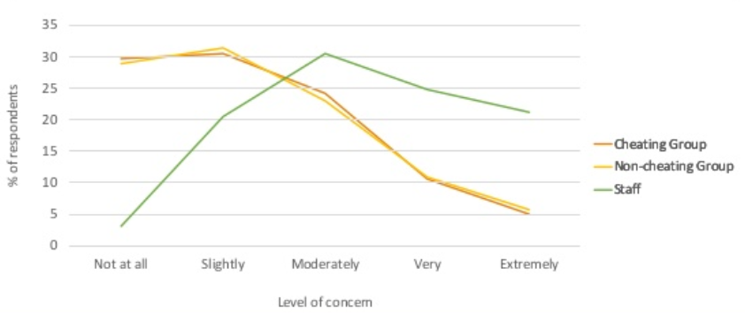
Student concern
https://cheatingandassessment.edu.au/wp-content/uploads/2018/09/STUDENT-RESOURCE-Contract-cheating-not-victimless-crime.pdf

Slide 5
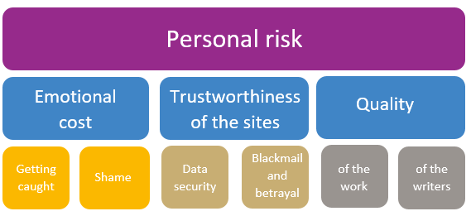
Risks of contract cheating
Rowland, Slade, Wong and Whiting (2018).

Slide 6
File-sharing sites
Commercial file-sharing sites let you buy, sell or trade academic content.
They may offer some genuine help services, but they also profit from the upload of student-generated and university-owned materials.
These sites include:
Using these sites places you at risk of academic misconduct.
.
.

Slide 7
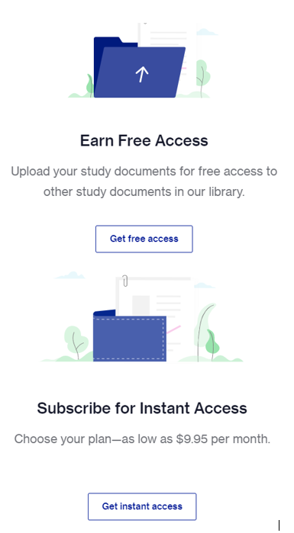
Access to sites
Users:
Pay a fee to download content
OR
Upload content to earn credits which can later be redeemed to download other content
Course Hero. (n.d.). Get Started with Course Hero © 2022. Retrieved 21January 2022, from https://www.coursehero.com/ Screenshot by Rutherford, P. G.

Slide 8
Legitimising strategies used by file-sharing sites
Strategies used by these sites to lure students:
Normalising of file-sharing behaviour
Sponsor student events
Ambiguous about collaboration
Use of social media and campus ambassadors
Adapted from Stoesz, B. M., & Seeland, J. (2020, August). Sharing is caring? Exploring academic integrity and file-sharing behaviours. Presented virtually for the Taylor Institute for Teaching and Learning, University of Calgary, Calgary, AB.
StuDocu. (n.d.) You're in good company. © 2010-2020. Retrieved 21 January, 2022, from https://www.studocu.com/en-au. Screenshot by Rutherford, P.G..

Slide 9
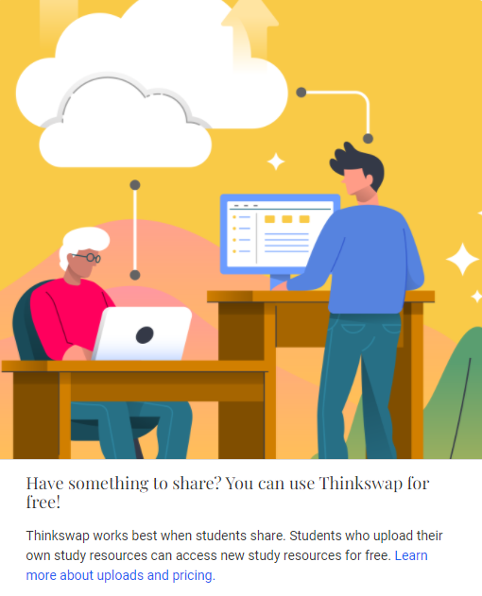
Legitimising strategies used by file-sharing sites
Elude blocking filters when classified as ‘online shopping’
Positioned as ‘cutting edge’
Positioned as opponents of academic cheating
Capitalise on the uncertainty, stress, and anxiety related to COVID
Adapted from Stoesz, B. M., & Seeland, J. (2020, August). Sharing is caring? Exploring academic integrity and file-sharing behaviours. Presented virtually for the Taylor Institute for Teaching and Learning, University of Calgary, Calgary, AB.
Thinkswap. (n.d.) Welcome to the best study guide in Australia. © 2010-2020. Retrieved 21 January, 2022, from https://https://www.thttps://www.thinkswap.com/au#how-it-works. Screenshot by Rutherford, P.G..

Slide 10
Legitimising strategies used by file-sharing sites
Sponsor professional development events and resources for educators
Entice users with a credit system or special offers
Marketed as homework help, note-sharing, study resources, ed tech, student support, student community, etc.
Adapted from Stoesz, B. M., & Seeland, J. (2020, August). Sharing is caring? Exploring academic integrity and file-sharing behaviours. Presented virtually for the Taylor Institute for Teaching and Learning, University of Calgary, Calgary, AB.
Thinkswap. (n.d.). Thinkswap sign up for free. © 2010-2020. Retrieved 21 January, 2022, from https://www.thinkswap.com/sign-up. Screenshot by Rutherford, P.G..

Slide 11
Avoiding academic misconduct - uploading
Activity on sharing platforms you must avoid are:
Uploading your assessments, whether they be exams, assignments, essays, reports, coding tasks, etc. for others to use to cheat.
Uploading course materials, e.g. PowerPoint slides or class notes as this is a violation of the lecturer’s intellectual property rights.
Course Hero. (n.d.). Looking for Free Course Hero access? © 2022. Retrieved 21January 2022, from https://www.coursehero.com/free-access/ Screenshot by Rutherford, P. G.

Slide 12
Avoiding academic misconduct - downloading
Downloading work completed by others and submitting all, or part of it as your own work without it being acknowledged, and
Obtaining answers for any assessable item such as exams, quizzes, homework tasks etc.
N.B. This activity applies equally to privately shared sites such as Facebook, WeChat or other sharing apps where students may have set up pages for sharing.

Slide 13
Legitimate support
Help is available from legitimate sources if you are experiencing difficulty with your course work.
Contact your course teaching team for guidance and support.
Student Services provides support to help you prepare for your assignments, plan your work and manage stress under pressure.
The Library has a range of services and programs which will help you with your study.

Slide 14
UQ takes academic misconduct seriously
Incidences
January 2017–December 2021: UQ dealt with nearly 9,900 cases of academic misconduct.
Penalties
Penalties include:
re-submission of an assessment or automatic failure of a course (lower-end offences)
suspension or expulsion
a combination of penalties.

