Slide 1
Introduction to AI and UQ Support

Slide 2

Contents
What is AI?
  Introduction to AI
AI Student Hub
  AI in your learning
  Ethical and responsible use of AI
  UQ AI tools for students
  Training & Resources
AI and assessment
  Maintaining academic integrity
  Example course 1 – Law
  Example course 2 – Architecture
  Example course 3 – Dentistry

Slide 3
Introduction to AI
What is AI?
Artificial Intelligence (AI)
AI is embedded in our digital world, performing specific tasks based on rules or data.
For example:
Grammarly
Microsoft Word editor tools
Google
Machine Translation (MT)
Automated process converting text from one language to another.
For example:
Translating a website into another language
Converting an assessment you wrote to another language
Generative AI (GenAI)
Creates new outputs based on existing data.
For example:
ChatGPT
Microsoft Copilot
Adobe Firefly
Synthesia

Slide 4





Artificial Intelligence
New generative AI tools (e.g. ChatGPT) can write essays and code, create images, generate music and videos, write and explain concepts, and provide step by step solutions to questions.
AI technologies are rapidly changing the job market; they may also change the way you study.
AI tools can be incorrect or misleading.

Slide 5


Slide 6
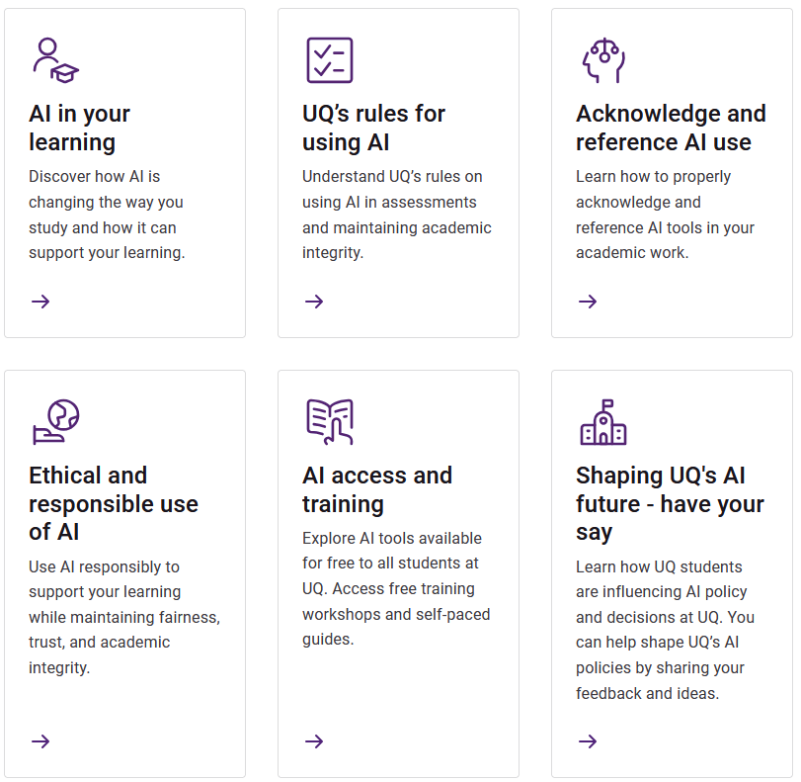
AI Student Hub
Use AI responsibly and effectively in your studies.
Always check your course profile to find out if AI is allowed for each assessment task.

Slide 7

AI in your learning
How AI can help you learn
Using good prompts or instructions in AI tools is a good start to get more relevant outputs. Visit the AI Student Hub for resources on creating good AI prompts.
Using AI can help to explain, practice, study and revise, and apply concepts in your learning journey.
How AI can hurt your learning
While AI tools are very powerful, they have a range of limitations:
AI models that recombine information to produce responses also produce inaccuracies.
Information is often produced without acknowledgement or reference to the source of that information.
The data used to train the models has biases and these biases can be amplified.
AI tools are modelled to imitate aspects of intelligence, but they do not have the same capabilities as humans.
AI-suggested changes may change your intended meaning, even if only used for editing assistance.
Image source: LuxeShutter24/peopleimages.com on Adobe Stock

Slide 8
Ethical and responsible use of AI
Checklist for ethical AI use
A Checklist for ethical AI use is located on the AI Student Hub.
Use this checklist to:
Consider the important of engaging ethically and responsibly with AI in your learning.
Stay aligned with UQ’s values and your personal learning goals.
Visit the AI Student Hub for further guidance and resources on the ethical and responsible use of AI.
Notes:
The checklist was inspired by UQ students’ reflections during focus groups, highlighting the importance of engaging ethically and responsibly with AI in learning. It aims to guide you in using AI responsibly while maintaining fairness, trust, and academic integrity.

Slide 9

UQ (free) AI tools for students
AI tools provided by UQ for you to use for free include:
Microsoft Copilot is the recommended tool at UQ.
      Copilot provides data protection and will not use your prompts or responses to train their foundation models.
      You can generate text and images via the chat interface.
Adobe Creative Cloud software is available via UQ.
      You can design videos, flyers, presentations and more using Adobe Express, and Firefly to generate images.
  You may use and explore AI tools for which UQ does not have licences. When discipline-specific software is required for assessment that uses AI, your course coordinator will organise access.
Image source: pikselstock on Adobe Stock

Slide 10

Training and resources
Training workshops
UQ Library offers hands-on online and in-person workshops.
Student support through Study skills and learning advice offers learning workshops.
Online self-paced guides
Artificial Intelligence Digital Essentials module
LinkedIn Learning online courses
Generative AI Essential Guide: Unlock Your Learning Sciences at UQ
The University of Sydney’s AI in Education
Open AI’s A Student’s Guide to Writing with ChatGPT
Visit the AI Student Hub for further guidance on AI access and training.
Image source: THANANIT on Adobe Stock

Slide 11
AI and your assessment

Slide 12

Maintaining academic integrity
Acknowledging and referencing how you have used Artificial intelligence (AI) for your assessment shows honesty, transparency, and respect for the work of others.
For every assessment task, before you submit it, answer these three questions:
      Is this assessment task my intellectual and academic work?
      Have I followed the instructions of my course coordinator about using and acknowledging or referencing AI?
      Am I submitting work that demonstrates my learning, skills, and abilities?
If you answer no to any of these questions, then you could be breaking UQ’s AI rules. Why? Because:
inappropriate use of AI is academic misconduct
inappropriate acknowledgment of AI use is academic misconduct.
Image source: peshkova on Adobe Stock

Slide 13
Your assessment in this course
LAWS1234 Introduction to Law
Assessment task | Weight | Due date | AI use
Law reform submission | 20% | Week 7 | Can use AI
Law reform defense | 30% | Week 8 | Cannot use AI
End of semester exam | 50% | Examination period | Cannot use AI

Slide 14
Assessment 1 – Law Reform Submission
Topic questions on an area of law reform will be added; you will select ONE of these topics for your submission.
Expected to use course materials and conduct independent research and analysis on the chosen area of law reform.
Report should include an outline of the current state of the law, identify existing problems and deficiencies, and a potential reform proposal.
Word count: 2000 ± 10%
You can use AI – where AI tools are used, they must be acknowledged.
Acknowledging use of AI
For this assessment item, you will be required to acknowledge use of AI in a cover sheet. This includes identifying what tools you used and what you used them for.

Slide 15
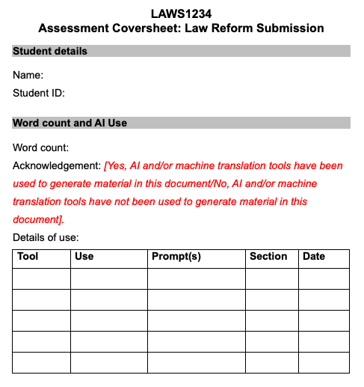
Assessment 1 – Law Reform Submission
Assessment coversheet
The following cover sheet is available on Blackboard for your use for this assignment.
For example:
Tool | Use | Prompt(s) | Section | Date
ChatGPT 4o | Exploring other viewpoints | Provide an alternative argument for the following deficiencies on [law]: [list of three deficiencies] | Deficiencies of existing law | 28/1/25
AI Student Hub and UQ Library provides further guidance on acknowledging and referencing AI.

Slide 16
Assessment 2 – Law Reform Defence
Engage in a one-on-one discussion with a tutor to defend your written law reform submission.
This discussion will focus on your chosen topic, research findings, analysis and proposed reforms. Provides an opportunity to demonstrate your critical thinking, legal reasoning and communication skills while engaging with the material you have researched.
Example questions:
    How did your research findings influence your analysis and the development of your reform proposal?
    Can you explain the legal and ethical implications of your proposed reform?
  10 – 15-minute discussion with a tutor in your tutorial class time.
You cannot use AI in this assessment.
You cannot use AI: AI is prohibited.
For this assessment item, you are not permitted to use AI. If you use AI in this assessment task you could be found guilty of cheating.

Slide 17
Assessment 3 – Exam
Final exam will be held during end-of-semester exam period.
Will assess all course materials covered during the semester.
You cannot use AI in this assessment.
You cannot use AI: AI is prohibited.
For this assessment item, you are not permitted to use AI. If you use AI in this assessment task you could be found guilty of cheating.

Slide 18
Your assessment in this course
ARCH1234 Introduction to Architecture
Assessment task | Weight | Due date | AI use
Mid-term presentation | 25% | Week 7 | Preparation: Can use AI Presentation: Cannot use AI
Design Project | 50% | Week 12 | Can use AI
Industry Panel Presentation | 25% | Week 13 | Cannot use AI

Slide 19
Assessment 1 – Mid-term presentation
Group presentation.
Develop and present a conceptual design for an architectural project based on assigned project brief.
Preparation:
  Develop a conceptual design for an architecture project.
  Need to include core design principles, site analysis, and the integration of creative and functional solutions.
  You can use AI for the preparation of this assessment.
  Presentation:
  Groups will present their work to peers and the tutor.
  10-minute presentation with 5-minute Q&A.
  You cannot use AI for the live presentation of this assessment.
Acknowledging use of AI for preparation.
For the preparation of this presentation, you will be required to acknowledge use of AI in a cover sheet. This includes identifying what tools you used and what you used them for.
You cannot use AI during the live presentation of this assessment.
During the presentation, you are not permitted to use AI. If you use AI in this component, you could be found guilty of cheating.

Slide 20
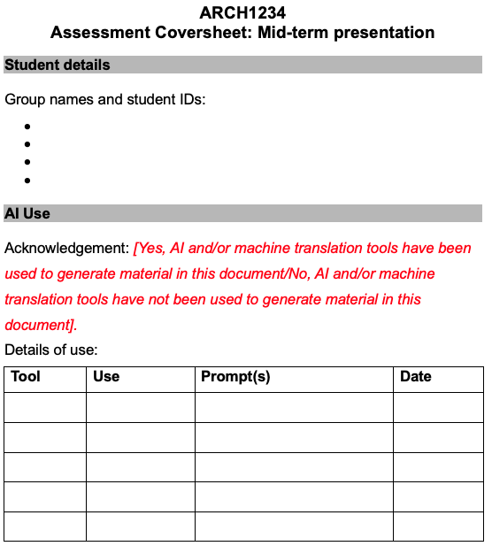
Assessment 1 – Mid-term presentation
Assessment coversheet
The following cover sheet is available on Blackboard for your use for this assignment.
For example:
Tool | Use | Prompt(s) | Date
Canva AI Presentation maker | Draft slide deck presentation | Create a semi-formal presentation for a workplace audience | 28/1/25
AI Student Hub and UQ Library provides further guidance on acknowledging and referencing AI.

Slide 21
Assessment 2 – Design project
You need to design and prototype a product.
You can use AI in this assessment for ideation and drafting – where AI tools are used, they must be acknowledged.
Acknowledging use of AI
For this assessment item, you will be required to acknowledge use of AI in a cover sheet. This includes identifying what tools you used and what you used them for.

Slide 22
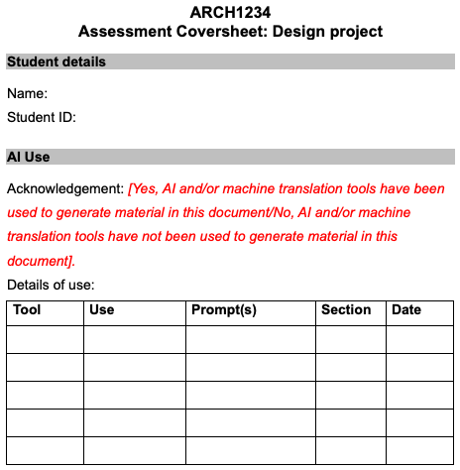
Assessment 2 – Design project
Assessment coversheet
The following cover sheet is available on Blackboard for your use for this assignment.
For example:
Tool | Use | Prompt(s) | Section | Date
Lumion AI | Idea generation | Generate an urban environment with a modern skyscrapers, mid-rise buildings, and parks surrounding the central building. | N/A | 28/1/25
AI Student Hub and UQ Library provides further guidance on acknowledging and referencing AI.

Slide 23
Assessment 3 – Panel presentation
Present your design project to an industry panel (comprising faculty and guest professionals).
Q&A with panel members.
You cannot use AI in this assessment.
You cannot use AI: AI is prohibited.
For this assessment item, you are not permitted to use AI. If you use AI in this assessment task you could be found guilty of cheating.

Slide 24
Your assessment in this course
DENT1234 Introduction to Dental Practice
Assessment task | Weight | Due date | AI use
Practical/ Demonstration | 20% | Week 8 | Cannot use AI
Presentation | 15% | Week 10 | Can use AI
OSCE | 20% | Week 12 | Cannot use AI
Examination | 45% | Exam period | Cannot use AI

Slide 25
Assessment 1 – Pre-clinical Skills Assessment
Conducted in Pre-clinical Laboratory.
Invigilated in person.
This assessment takes the form of cavity preparation tasks using instrumentation and the LearnaPrep block, and self-assessment of performance to demonstrate acquisition of manual dexterity, handpiece handling, fine motor control, safe practice and reflective practice skills.
  You cannot use AI in this assessment.
You cannot use AI: AI is prohibited.
For this assessment item, you are not permitted to use AI. If you use AI in this assessment task you could be found guilty of cheating.

Slide 26
Assessment 2 – Case Review & Product Recommendation
Presentation conducted in tutorial sessions.
Facilitated by tutor in person.
Students are required to review a clinical case scenario and recommend a product (specific to the case scenario) used in preventative or restorative dentistry in the form of a short video recording.
You can use AI in this assessment – where AI tools are used, they must be acknowledged.
Acknowledging use of AI
For this assessment item, you will be required to acknowledge use of AI using AI planner and cover sheet provided.

Slide 27
Assessment 3 – Objective Structured Clinical Examination (OSCE)
You cannot use AI: AI is prohibited.
For this assessment item, you are not permitted to use AI. If you use AI in this assessment task you could be found guilty of cheating.
Conducted during the Week 10 lab session.
Facilitated by examiner in person.
Students are individually assessed on their performance of several specified procedures which they have learned by completing the Simulation session during the semester.
  You cannot use AI in this assessment.

Slide 28
Assessment 4 – End of Semester Examination
Conducted during exam period.
Invigilated in person.
Closed Book examination - no written materials permitted.
A sixty (60) minute examination containing multiple choice and short answer questions covering all the course learning material delivered for a possible sixty (60) marks.
This is a hurdle (MUST PASS) assessment item. Students must achieve a minimum of 50% to pass.
  You cannot use AI in this assessment.
You cannot use AI: AI is prohibited.
For this assessment item, you are not permitted to use AI. If you use AI in this assessment task you could be found guilty of cheating.

